Slide 1



"Predicting and Classifying World Happiness Scores using Machine Learning"
Machine Learning Project - World Happiness Report
Nishtha Yadav

Slide 2

Introduction:
The World Happiness Report ranks countries based on happiness levels.
Uses metrics like GDP per capita, social support, life expectancy, and perceptions of corruption.
Importance:
Helps governments and policymakers understand well-being and improve quality of life.
Provides insights into economic, social, and health-related factors that influence happiness globally.
Project Goals:
Analyze and understand factors affecting happiness.
Cluster countries based on happiness and economic factors.
Predict happiness scores using regression analysis.
Classify countries into happiness tiers (High, Medium, Low)

Slide 3
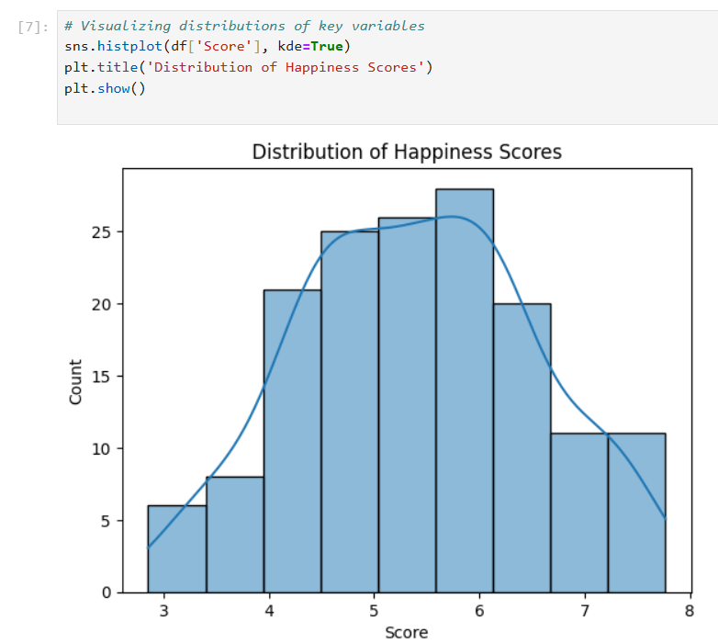
Exploratory Data Analysis (EDA)
Happiness Distribution: Most countries have happiness scores between 4 and 7.
Highly Correlated Factors:
GDP per capita and social support show strong positive correlations with happiness.
Healthy life expectancy also correlates positively with happiness.
Interesting Patterns:
Some countries with high GDP have relatively low happiness scores, possibly due to other social or cultural factors.

Slide 4


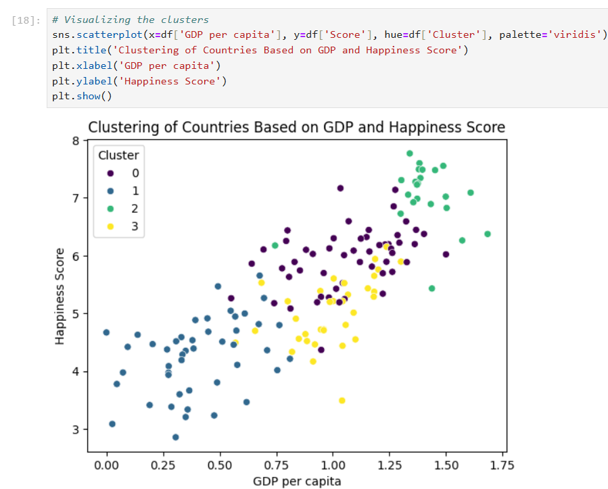
Clustering Analysis
Purpose of Clustering:
Group countries with similar happiness and economic characteristics.
Helps identify patterns and groupings for policy-making and comparison across regions.
Method:
Applied K-means clustering to group countries based on happiness score, GDP per capita, social support, and other metrics.
Key Findings:
Identified 4 distinct clusters:
Cluster 0: Countries with high happiness and GDP.
Cluster 1: Countries with moderate happiness and social support.
Cluster 2: Countries with low happiness despite high GDP.
Cluster 3: Countries with low happiness and economic metrics.

Slide 5

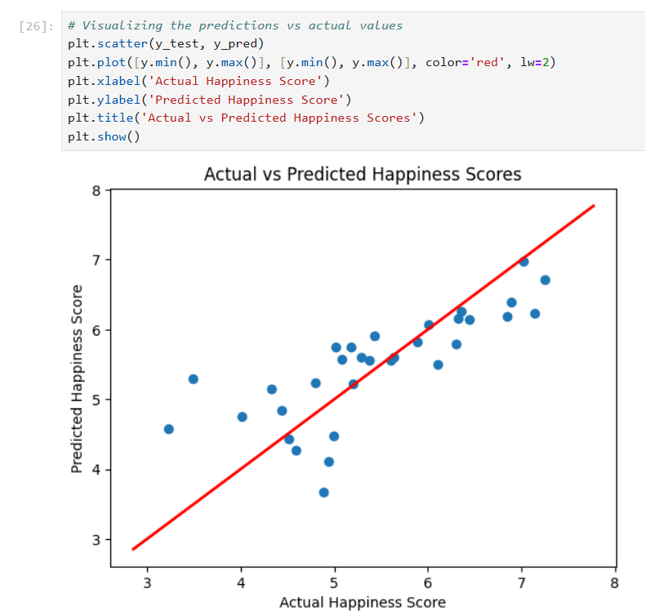

Regression Analysis
Regression Approach:
Applied Linear Regression to predict happiness scores based on key factors.
Features Used:
Predictors included GDP per capita, social support, healthy life expectancy, freedom to make life choices, and more.
Model Evaluation:
Mean Squared Error (MSE): 0.41 (shows how close predictions are to actual values; lower is better).
R-squared: 0.60, indicating the model explains 60% of the variance in happiness scores.

Slide 6
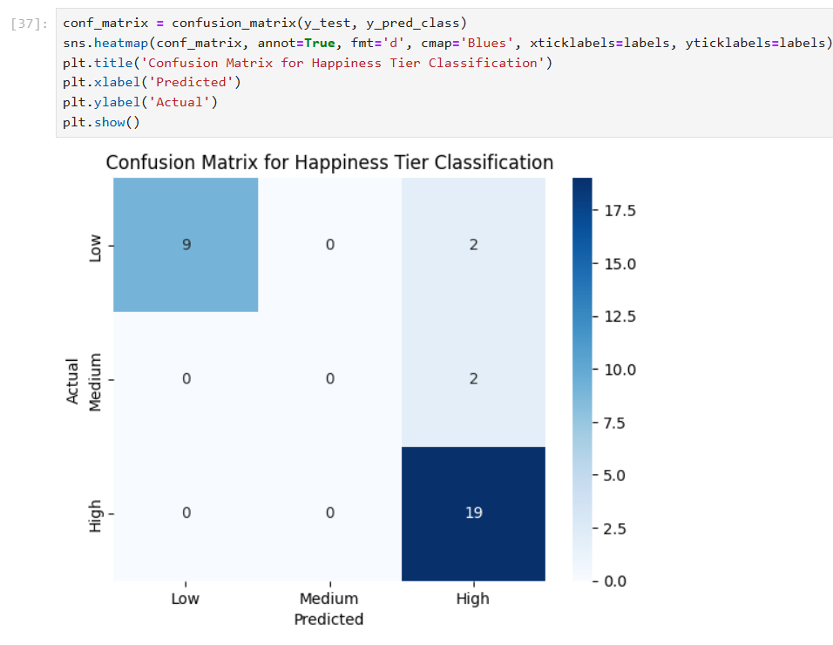









Classification Analysis
Grouped countries into "High," "Medium," and "Low" happiness tiers.
Helps simplify comparisons and assists in policy-making and resource allocation by identifying countries in need of support.
Classification Algorithm:
Used Logistic Regression to classify countries into the three happiness tiers based on GDP, social support, life expectancy, and other metrics.

Slide 7
Conclusion & Future Work
Summary of the Project:
Exploratory Data Analysis (EDA) revealed important correlations between happiness scores and factors such as GDP per capita, social support, and life expectancy.
Clustering Analysis identified distinct groups of countries based on happiness and economic metrics, providing insights into global trends.
Regression Model achieved an R-squared value of 0.60 and a Mean Squared Error of 0.41, effectively predicting happiness scores using features like GDP and social support.
Classification Model performed well with 87.5% accuracy, although some challenges were noted in classifying the "Medium" happiness tier.

Slide 8

Future Work:
Model Improvement:
Enhance the classification model: Consider using Random Forests or XGBoost to improve accuracy and handle imbalances in the data.
Advanced regression models: Use Polynomial Regression or Neural Networks for more complex patterns in predicting happiness.
Additional Features:
Incorporate other factors like education levels, mental health indices, or environmental factors for more precise predictions and classifications.
Practical Applications:
These insights can assist policymakers in identifying regions that may need targeted economic or social interventions.
Governments could use this analysis to allocate resources and design policies aimed at improving citizen happiness and well-being.

Slide 9
Thank you!

